Slide 1
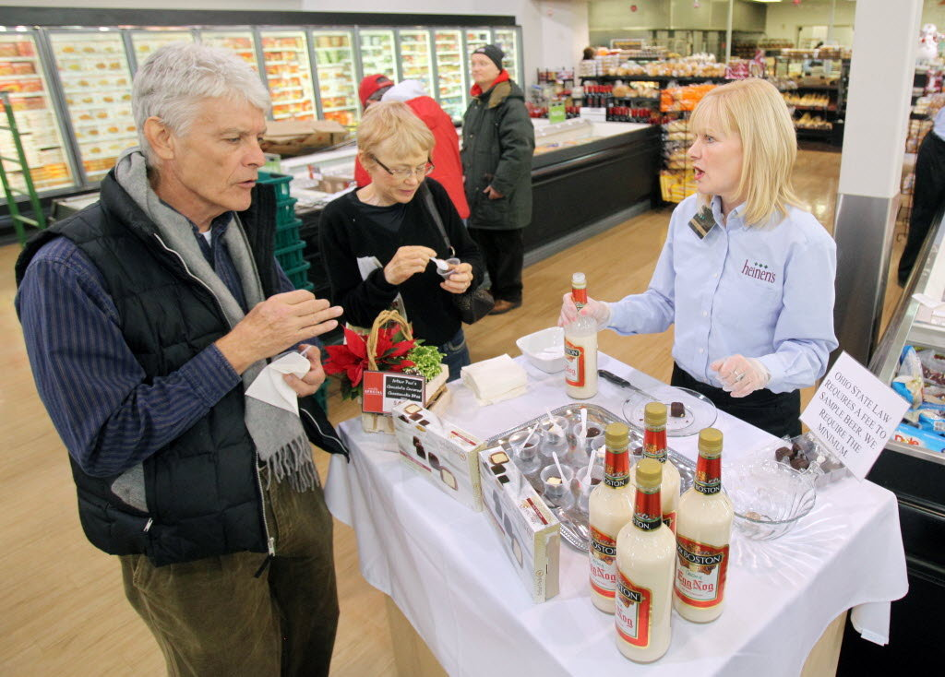
Sampling
Geog4300/6300
Jerry Shannon

Slide 2
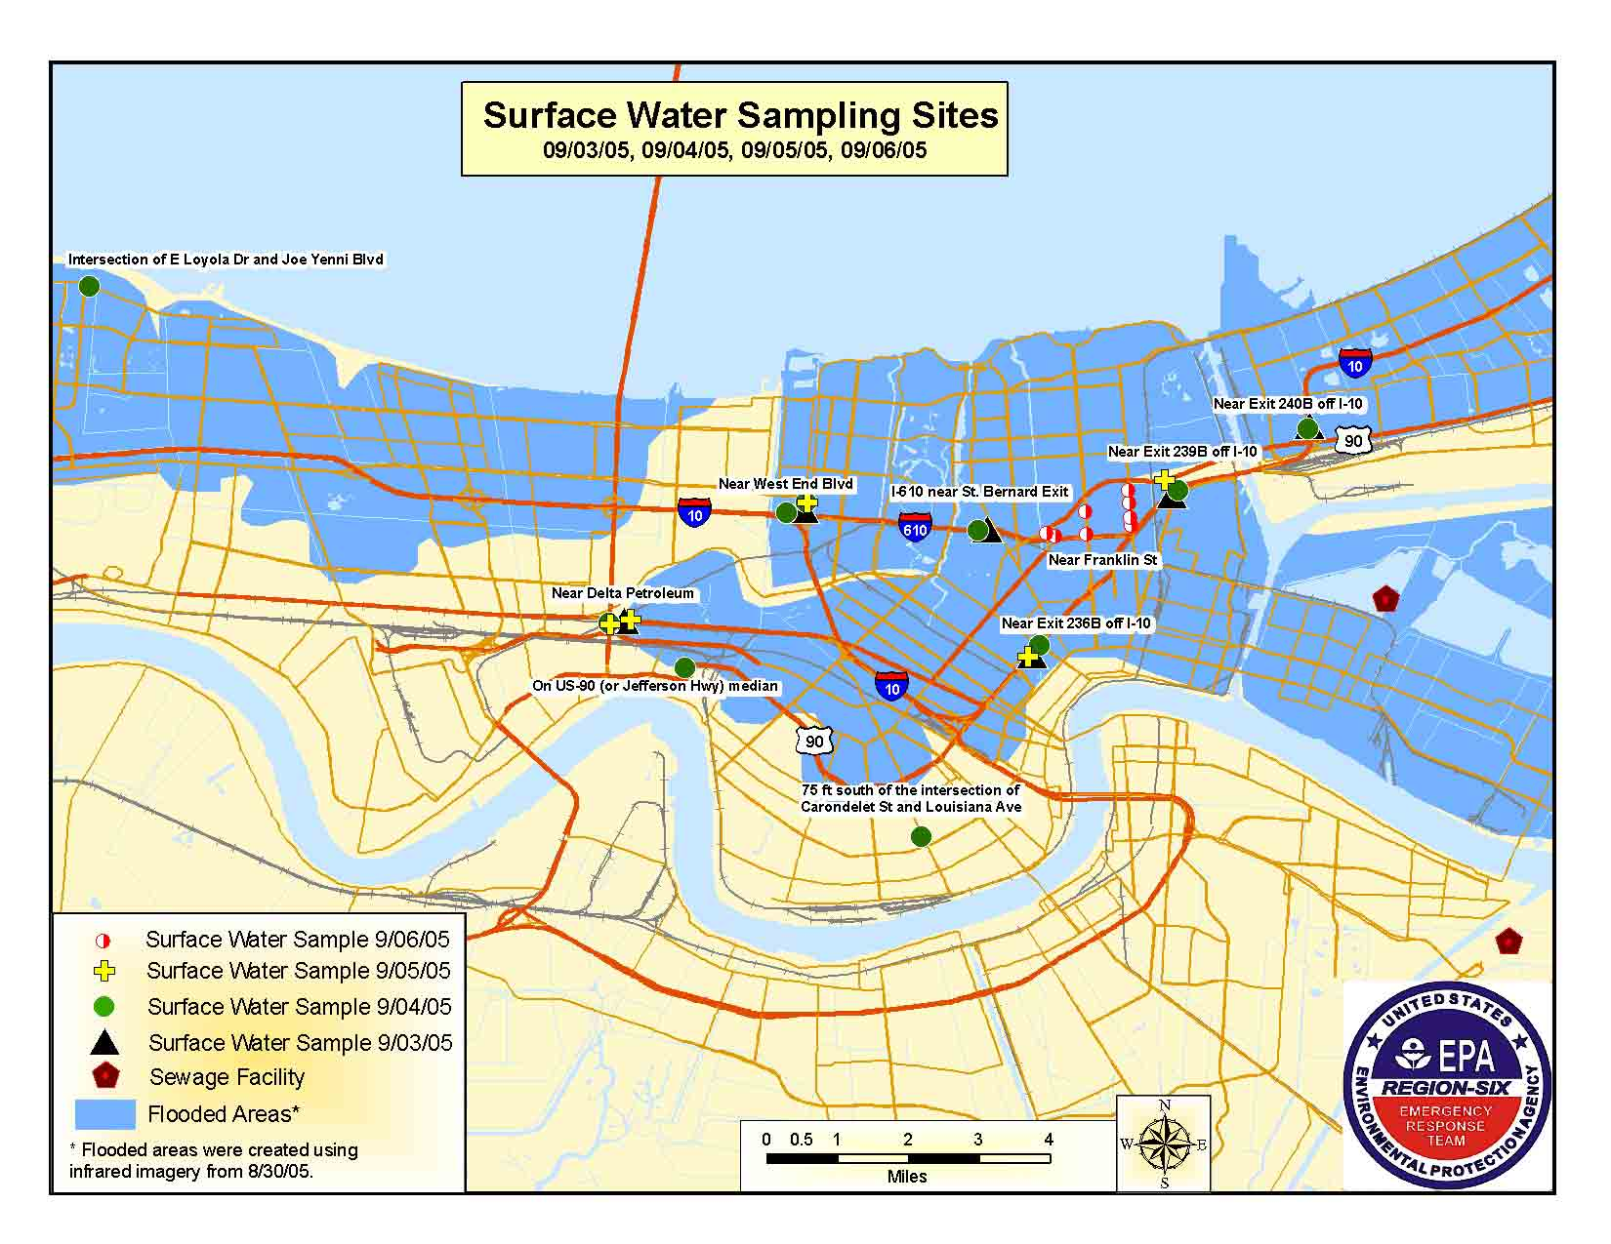
Why sample?
Saves money
Saves time
Full sample may be impossible/impractical

Slide 3

Sample research question:
Do veterans find it easy to use their GI Bill educational benefits at state colleges and universities?

Slide 4
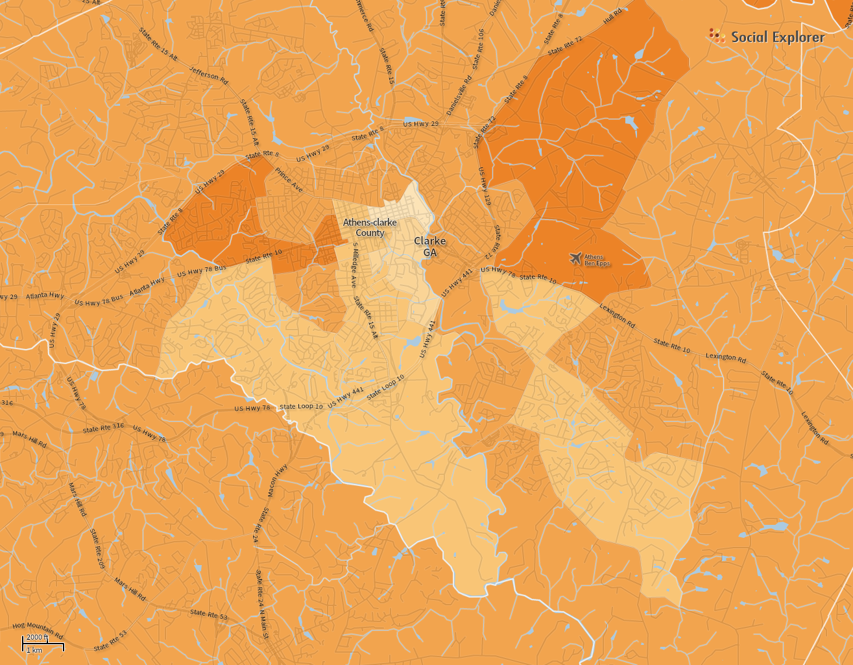
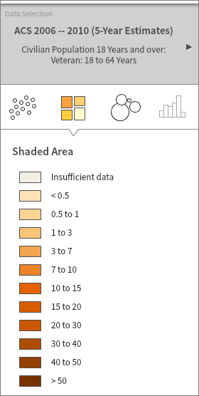
Some terminology
Target population and target area
(“Population” can mean many things…)
Veterans in Clarke County

Slide 5
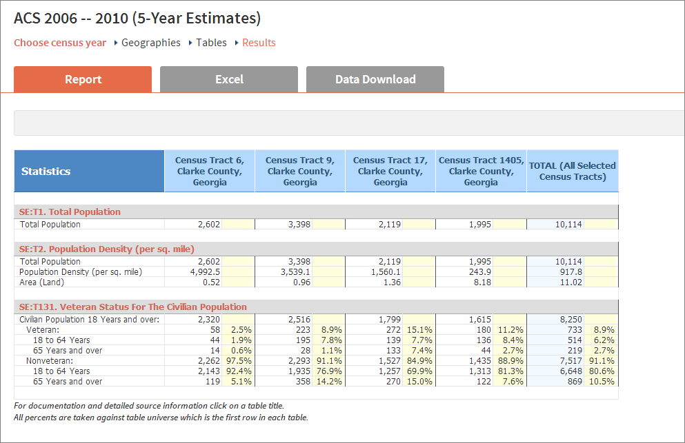
Some terminology
Sampling frame—population and area

Slide 6
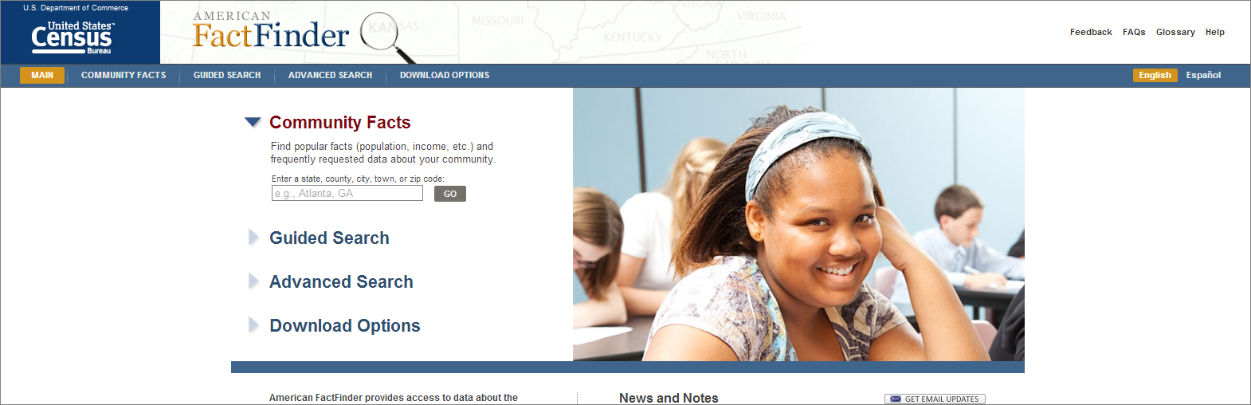
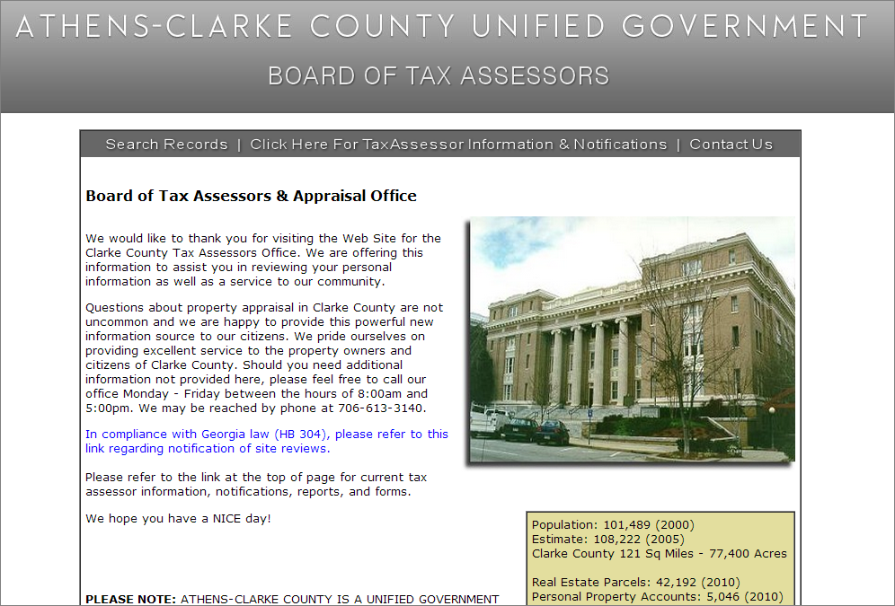
Sources of sampling frame data?

Slide 7
Non-probability sample Convenience
Snowball
Quota
Probability sample
Random
Systematic
Stratified
Cluster
Do some research!
Give a one minute summary of what this sampling strategy entails
How would it be used with our study of Clarke County veterans?

Slide 8
Finding sample size: Error of the mean
What is the mean number of articles read by Geography graduate students in a semester? You did a survey of 30 such students. The mean was 54.2 and the s.d. was 12.8.
How many students should you ask if you want your mean to be accurate to within three articles, with 95% confidence?

Slide 9
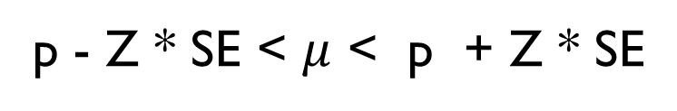
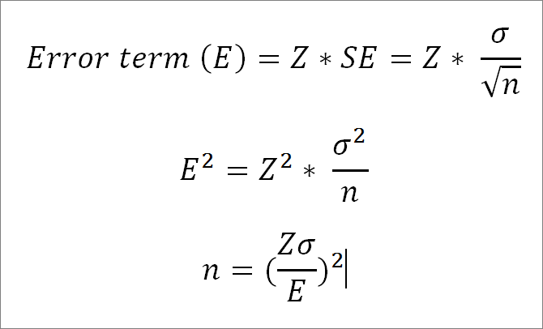
Finding sample size: Error of the mean

Slide 10
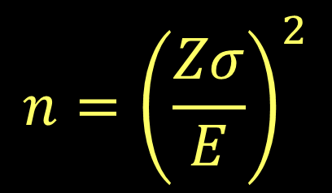
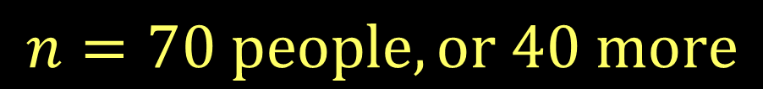
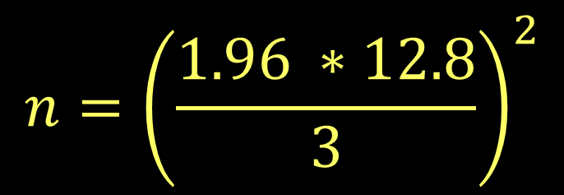
Finding sample size: Error of the mean
$$n={\left(\frac{Zσ}{E}\right)}^{2}$$
$$n={\left(\frac{1.96 ∗12.8}{3}\right)}^{2}$$
$$n=70 people, or 40 more$$

Slide 11
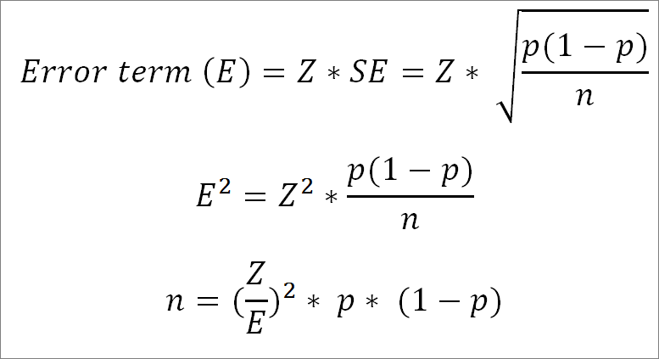
Finding sample size: Error of proportion

Slide 12
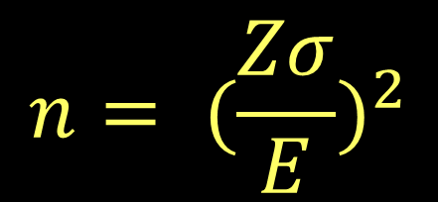
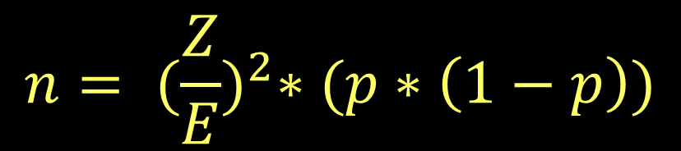
Finding sample size: Error of proportion
What if you wanted to know the proportion of grads reading 80 or more articles? Your initial survey suggests that 8.3% currently do so. How many more students would you need to have a margin of error less than 2% (with 95% confidence)?

Slide 13
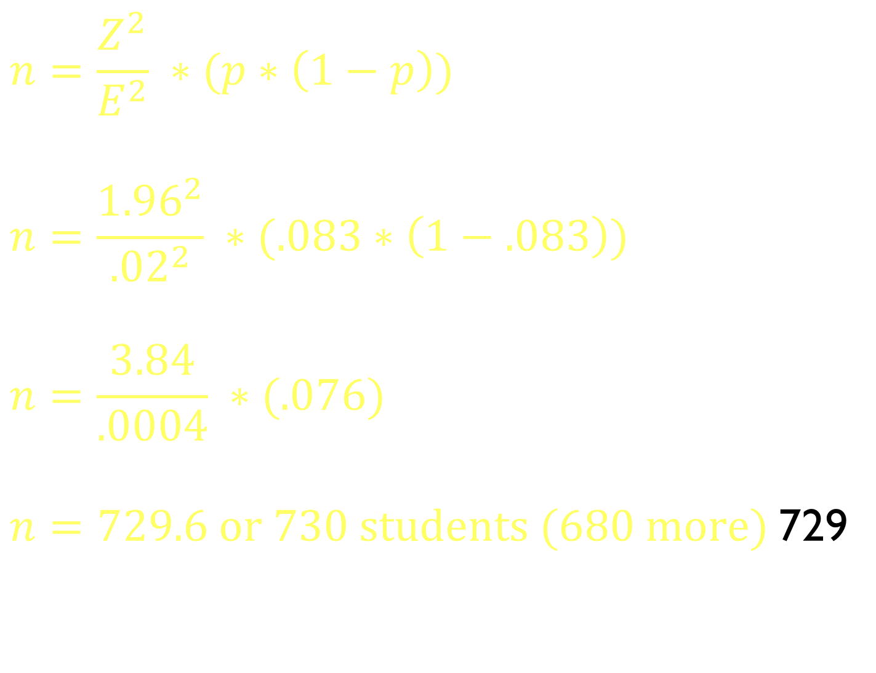
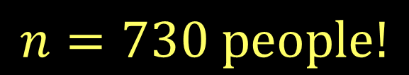
Finding sample size: Error of proportion
$$n=730 people!$$

Slide 14
Finding sample size: Error of proportion
What if we don’t have initial data?
A proportion of 0.5 produces the most conservative sample size estimate

Slide 15

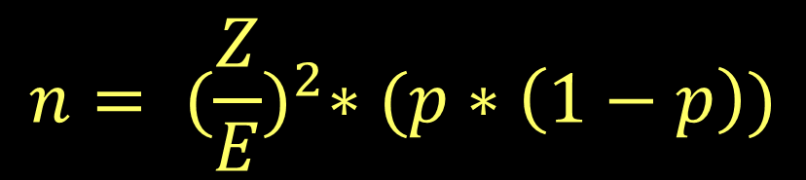
Practice
1. A study is seeking to find the number of televisions owned by graduate students. The national standard deviation is 1.2. Assuming the same variance, how many graduate students would need to be surveyed to have a 95% estimate with an accuracy of 0.5 televisions?
2. A survey estimated that 20% of all Canadians aged 16
to 20 drove under the influence of drugs or alcohol in the last year. A similar survey is planned for the US. They want a 95% confidence interval with a margin of error of 0.02 (2%). How large should the sample be?
Notes:
Q 1: 29.6 stores
Q 2: 1,536.6 people

Slide 16
Your final project!
It needs to do the following:
Include descriptive and inferential stats
Have some kind of spatial component
Make you work without a lab structure
Last year’s class:
Group analysis of election data
https://jshannon75.github.io/district_change/index.html
Notes:
Q 1: 29.6 stores
Q 2: 1,536.6 people

Slide 17
Questions
Group or individual project?
Data we already have (Census/Daymet/etc.) or new data?
Come up with two options in small groups.
Notes:
Q 1: 29.6 stores
Q 2: 1,536.6 people

